Slide 1

Faculty Advising
Advising Center
Bergen Community College
2017

Slide 2
What is faculty advising @ BCC
Contractual responsibility – full time faculty are required to advise students 14 hours per semester.
All advising hours are contractually required to be completed during the 15 week semester period.
ALL Exceptions must be arranged in advance and based on the needs of the Advising Center
Semester | Begin | End
Fall | September | December
Spring | January | May
Notes:
It is important to understand that the only advisors the college has – are you, the teaching faculty.

Slide 3
How can advising be completed
Where | What | Who | How
Advising Center | Faculty spend 14 hours in the advising center | Work with students on walk-in basis Scheduling and course selection most popular student request. See students with any program. | Hours must be scheduled at the beginning of the term Faculty should have a working knowledge of advising, college policies, web advisor and campus resources
Cohort Advising | Faculty commit to working with students enrolled in a specific program | Work with students via email, face-to-face. Advise students enrolled in a specific | Faculty should be part of specific program Faculty should understand degree requirements, remedial requirements & gen ed course
Notes:
There currently are a variety of ways that advising can be completed.

Slide 4
How can advising be completed
Where | What | Who | How
Athletic Team Advising | Faculty commit to working with a specific team. | Work with students via email, face to face, team meetings. Advise students in multiple programs | Faculty should have experience and knowledge with variety of programs and campus resources. Be aware of athletic schedule (practice/games) Monitor team enrollment.
Campus Events | Faculty spend 14 hours working at Admission Open Houses/ Major Fair/other | Represent the college and department at events. Meeting with prospective students & current. | Be able to answer basic questions about the college and program(s) Know College Resources and be able to discuss with students and/or families
Notes:
In each case faculty are required to understand how to access and read a program evaluation, help students create educational plans and campus resources for student referrals.

Slide 5

Advising VS Counseling
Question | Faculty Advisor | What kind of Counselor
I need to figure out what classes to take |  | Academic
I want to make sure the classes I take go toward my degree |  | Academic
I need guidance about issues related to academics |  | Academic
I want to discuss the content of the classes and what they are about
I want to explore some career interests that my program may lead to |  | Career Counselor
I want to discuss how and when to transfer |  | Transfer Counselor
I am on probation and need to register |  | Academic Counselor
Notes:
There remains a great deal of confusion regarding what faculty advisors do and what counselors do.
Faculty should concentrate on program requirements, creating educational plans and discussing academic issues with students – career, transfer, personal problems or questions can all be referred.

Slide 6
Center for Student Success | Counselors
Academic | Fred Golub Dallas Gray (Community Counselor Hackensack) Tim Foote Kim Smokowski (NJSTARS/Online) WinWinKyi (PTK/Honors)
Career | Gene Calderon Margaret McLaughlin (Transfer)
Transfer | Donna Crotti Michael Feder
Personal | Dr. Stafford Barton (Academic) John Giamo (Veterans & Meadowlands) Cristina Haedo (Community Counselor Hackensack) Eileen Purcell
OSS | Beth Pincus Linda Seidman
Notes:
Counselors are separated based on specialty area. Many of the counselors have other areas that they work with – like online, NJSTARS.
Additionally EOF and International students have specific counselors to meet with.

Slide 7

What do faculty advisors do?
As an advisor you are expected to:
• Understand and effectively communicate the curriculum, graduation requirements, and college policies and procedures
• Encourage and guide the student to define and develop educational goals
• Encourage and support the student to gain the skills to develop clear and attainable educational plans
• Provide the student with information and strategies for utilizing the available resources and services on campus
Notes:
Faculty advising really focuses on the student experience – providing information to the student so that they can learn how to navigate college. Advising is teaching.

Slide 8
What that means:
Faculty Advisors should be able to:
  Interpret test scores and placement and sequence of developmental courses
  Understand program requirements and general education courses
  Suggest campus resources
  Refer students to student services
  Explain academic policies and procedures
  Identify important deadlines and dates like add/drop, withdrawal, registration, tuition deadlines
Notes:
All faculty advisors should know how to answer questions in the following areas.

Slide 9

What do advisors use:
College website
Online catalog
Web Advisor
Program Evaluation
Additional tools:
Developmental Course Sequences
General Education Sheet
Schedule Grid
Academic Calendar
Do not advise any student without looking
At their program evaluation first!
Notes:
Tools used by advisors are all college resources

Slide 10
The Program Evaluation in Web Advisor
The courses required for the degree
The placement test Results & requirements
The courses that have been completed
The courses that are still needed
The student’s GPA
The student’s academic standing
Any holds
Review “TRANSCRIPT” for complete list of courses – transcript includes all withdrawn courses that are not reflected on program evaluation.

Slide 11
Developmental English aka EBS
English Basic Skills
The EBS requirement varies depending on the placement test results of each student.
Placement | Semester One | Semester Two | Semester Three | Semester Four
2 semesters of developmental EBS (10 credits) | EBS 011 | EBS 012 | Wrt 101 | WRT 201 (or maybe 202)
1 semester of developmental EBS ( 5 credits) | EBS 021 | WRT 101 | WRT 201 (or maybe 202)
1 semester support developmental class (2 credits) | WRT 101 & 033 | WRT 201 (or maybe 202)
1 semester support developmental class ( 1-credit) | WRT 101 & 041 | WRT201

Slide 12
Developmental Math
Math Placement is based on test results.
Placement | Description | Requirement
Math 010AL & Math 011AL | Paired class Computer assisted class (010) provides support for Math 011. Required for all students that TEST into it. | Math 010 – 1 cr Math 011 – 3 cr One semester
Math 011 | Basic Math Required for all students that TEST into it | 3 cr One semester
Math 012 | Accelerated basic Math | 1 cr This course can be completed in as few as 7 weeks

Slide 13
Algebra
Algebra Placement is based on test results & program of study. Confirm requirement with degree requirements. Please note, many AAS programs do not require algebra for graduation.
Course | Description | Requirement
Mat 040 | Algebra for Liberal Arts | 4 credit One semester Required based on degree
Mat 044 | Algebra Topics Bridge Course For students that completed 0404 and program requires Math 160 | 3 credits One semester Math 040 +044 = Math 048 Required based on degree
Mat 048 | Algebra | 5 credit One semester Required for students whose program of study requires Math 160

Slide 14
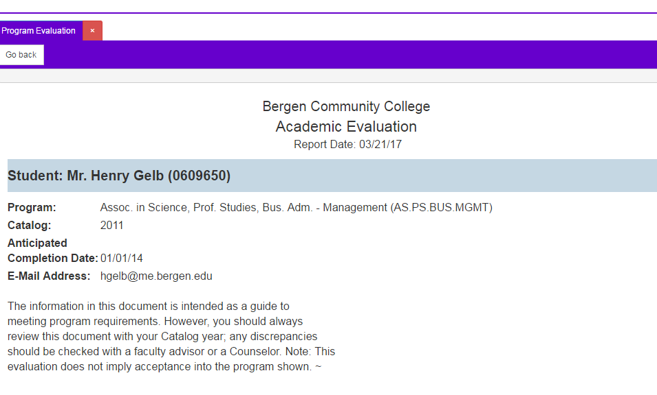
The Program Evaluation begins with:
Name of Student & BCC Student ID
Program of Study
Catalog Year
Completion Date
Email address
Notes:
When meeting a student confirm the name (spelling) and their program of study.
The Catalog year is when they applied to the college – but it also may impact their degree requirements (students in different catalog years MAY have different programs).

Slide 15
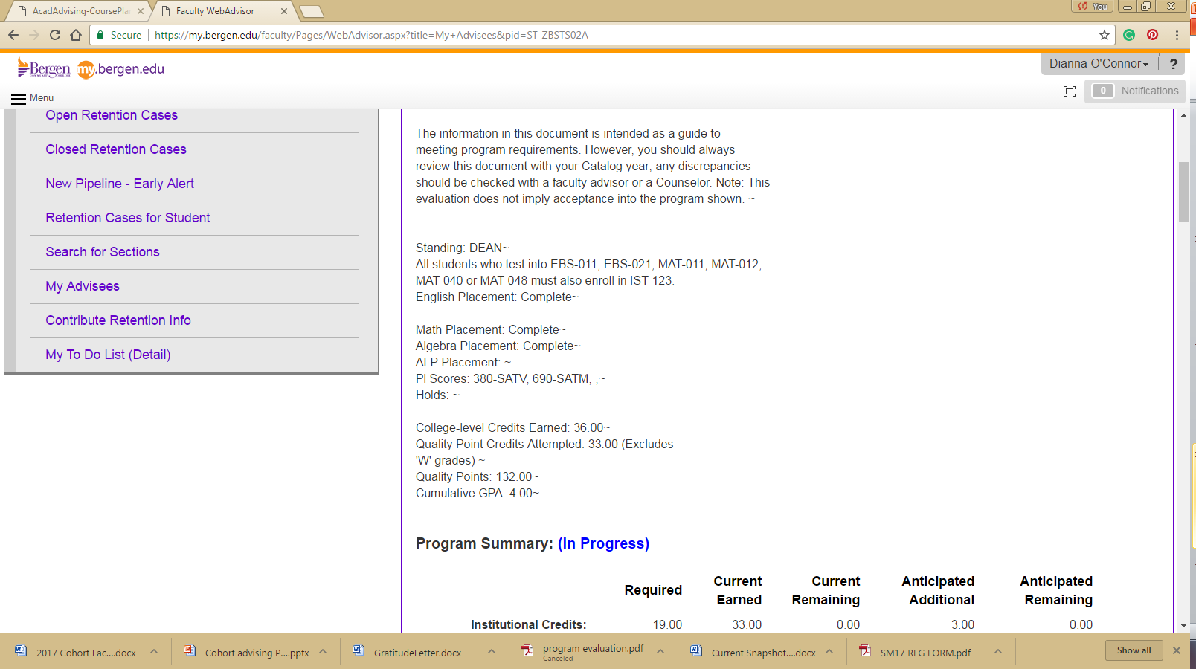
The next section shows:
1. Academic Standing 2. Remedial requirements and completion status
3. Holds 4. Credits & GPA (GPA must be at least 2.0 in order to graduate)
Notes:
Check holds each term. HIMM – immunization FAID – financial aid REG – registration BUR- bursar
Standing may be: Good, Dean, Honors, Prob- Probation SUSP – Suspension DISM – Dismissed
REG – registration BUR- bursar

Slide 16
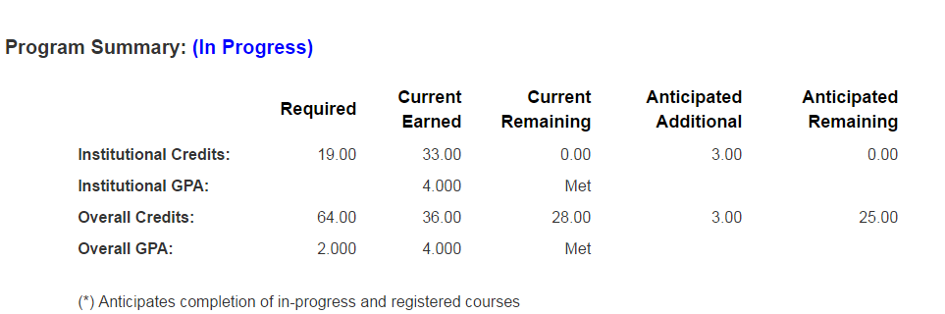
Program Summary:
.
Notes:
GPA and number of credits

Slide 17
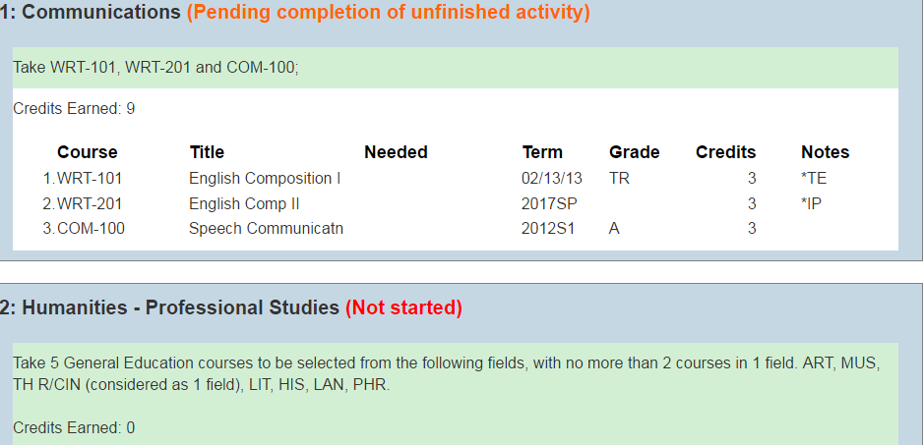

Web advisor breaks down degree requirements based on categories:
Status updated for each category
Notes:
Each category has status updates. Not started, In progress, Pending completion of unfinished activity, and Complete. They are color coded.
Each category gives information about the section – for example, Humanities – it tells the student 5 general education classes and no more than 2 classes in each field.

Slide 18
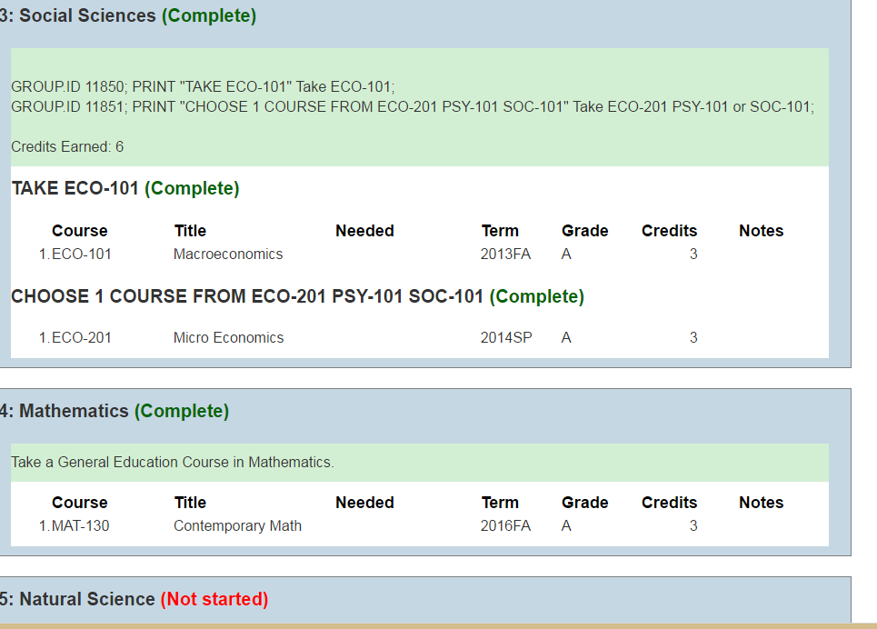
Notes:
Some categories tell student to take specific courses as in ECO 101 and 201.
Sometimes it tells them just to take a General Education course in a specific area.

Slide 19
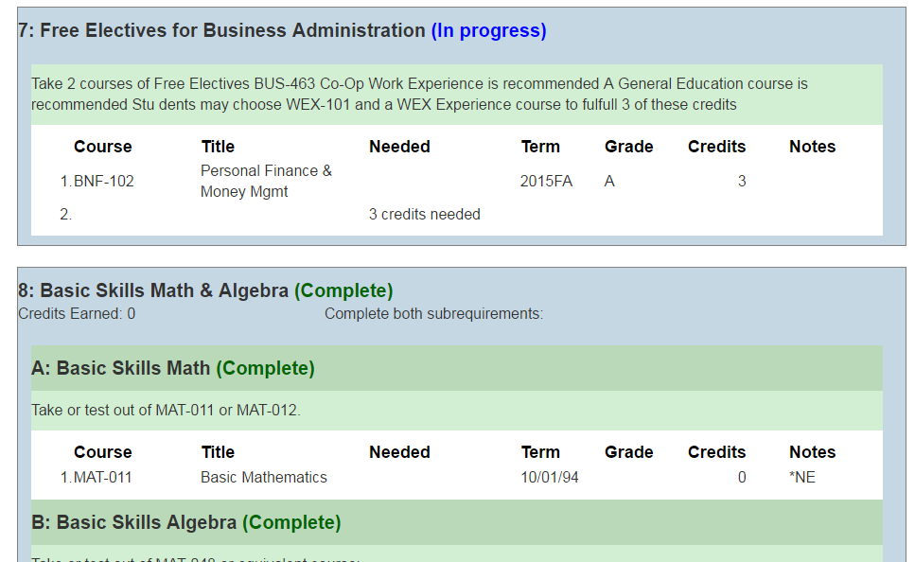
Notes:
Free electives often have course suggestions – based on program.
Remedial courses are based on test results and DEGREE Program. Many AAS program do not require Algebra, but some do. Some programs specifically say math 048 for others 040 is ok. It is very important to check this with the catalog requirements.

Slide 20
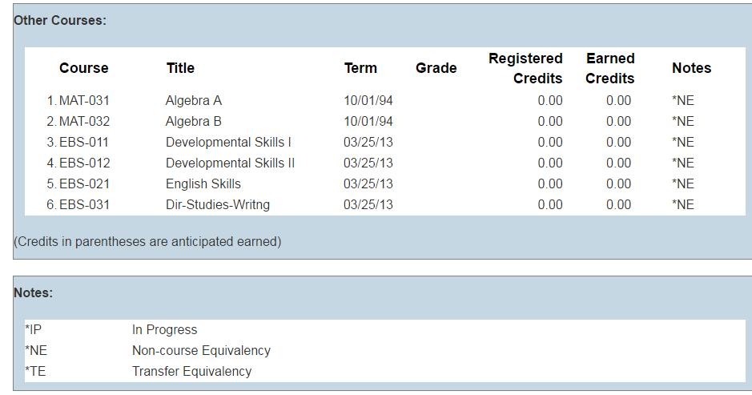
OTHER COURSES:
Notes:
OTHER COURSES – the last category on the program evaluation.
It lists:
When the placement test was taken
Courses that have been taken unsuccessfully (E & F)
Courses that have been transferred in but do not fit in program (extra courses)
Classes that are not part of the degree requirement.
Could be student changed programs and classes do not match new program
If an active class is listed or preregistered for – students should know why they have taken it
The notes describe the codes that are used in the evaluation.

Slide 21
Other courses
Sometimes students want to take a class that is not part of their degree.
  They can BUT they should understand it is not helping them graduate. But will be counted towards GPA.
  AND
  They should know that Financial Aid WILL NOT pay for the class.
  Financial Aid does not pay for any course that is not required by the degree.
  Below Other Courses is a category for Notes. It includes key for codes used in document.

Slide 22
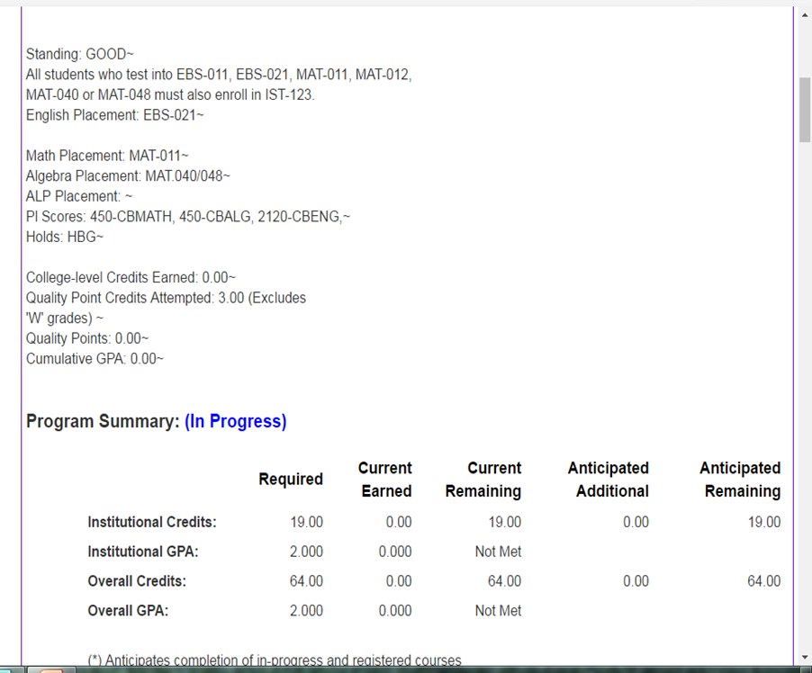
What do you see?

Slide 23
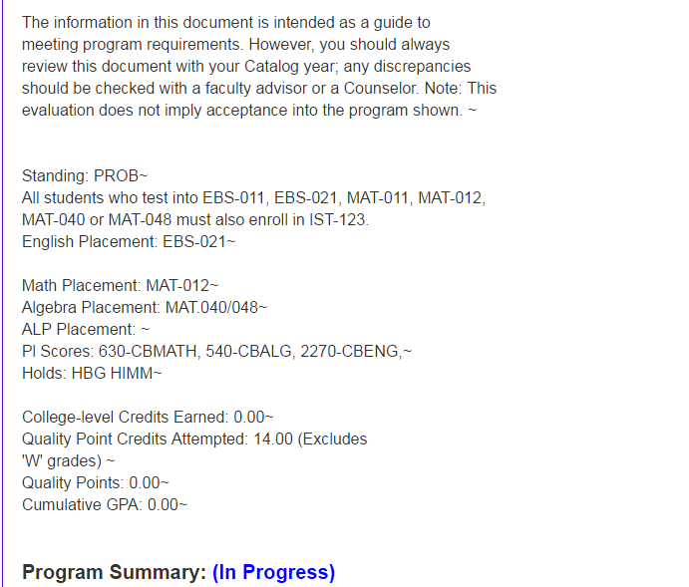
What do you see?

Slide 24
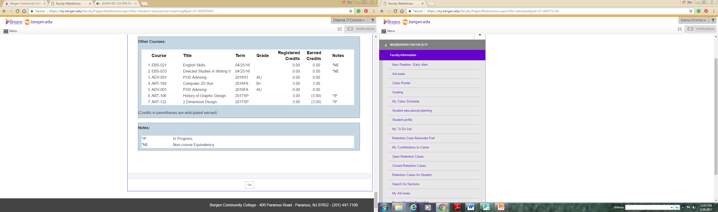
What do you see?

Slide 25
Summary
Program Evaluation should be checked carefully each semester – before and after registering for courses
Use this along with the degree requirements found in the online catalog
If any errors are detected student should contact Office of registration immediately
Graduating seniors should confirm their graduation via web advisor at least one full semester before graduating to confirm degree requirements

